Slide 1

VENKATRAMA PHANI KUMAR S Asst. Professor, Department of CSE VFSTR University
UNIT-I

Slide 2

Topics to be Covered
What Operating System do
Operating System structure
Process Concept
Overview
Process scheduling
Operations on process
Inter process communication
Process Scheduling
Scheduling Criteria
Scheduling Algorithms
Multiple-Processor Scheduling
Case Study: Process scheduling in Linux

Slide 3
Objectives
Students are able to
understand the basic organization of computer systems
provide a grand tour of the major components of operating systems
give an overview of the many types of computing environments
explore several open-source operating systems

Slide 4
What is an Operating System?
A program that acts as an intermediary between a user of a computer and the computer hardware
Operating system goals:
Execute user programs and make solving user problems easier
Make the computer system convenient to use
Use the computer hardware in an efficient manner

Slide 5
Computer System Structure
Computer system can be divided into four components:
Hardware – provides basic computing resources
CPU, memory, I/O devices
Operating system
Controls and coordinates use of hardware among various applications and users
Application programs – define the ways in which the system resources are used to solve the computing problems of the users
Word processors, compilers, web browsers.
Users
People, machines, other computers

Slide 6
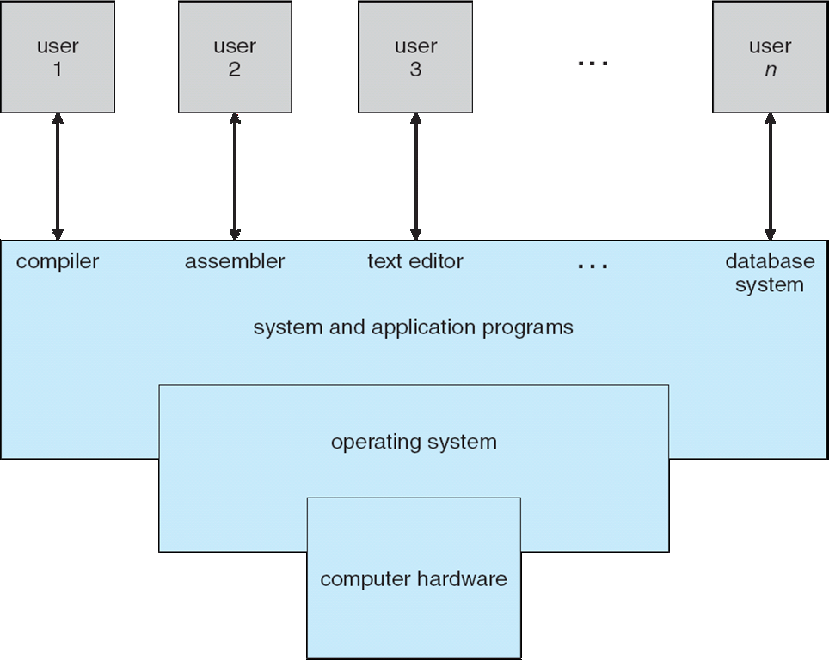
What Operating Systems Do
Depends on the point of view
Users want convenience, ease of use and good performance.
Don’t care about resource utilization
But shared computer such as mainframe or minicomputer must keep all users happy.
Four Components of a Computer System

Slide 7
What Operating Systems Do
Users of dedicate systems such as workstations have dedicated resources but frequently use shared resources from servers
Handheld computers are resource poor, optimized for usability and battery life
Some computers have little or no user interface, such as embedded computers in devices and automobiles.
OS is a resource allocator
Manages all resources
Decides between conflicting requests for efficient & fair use
OS is a control program
Controls execution of programs to prevent errors and improper use of the computer

Slide 8
Computer Startup
Bootstrap program is loaded at power-up or reboot
Typically stored in ROM or EPROM, generally known as firmware
Initializes all aspects of system
Loads operating system kernel and starts execution

Slide 9
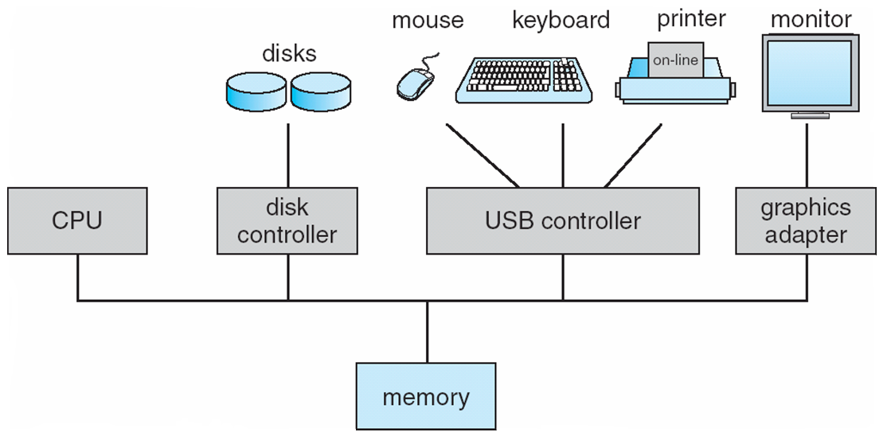
Computer System Organization
Computer-system
One or more CPUs, device controllers connect through common bus providing access to shared memory
Concurrent execution of CPUs and devices competing for memory cycles

Slide 10
Computer System Organization
I/O devices and the CPU can execute concurrently
Each device controller is in charge of a particular device type
Each device controller has a local buffer
CPU moves data from/to main memory to/from local buffers
I/O is from the device to local buffer of controller
Device controller informs CPU that it has finished its operation by causing an interrupt.

Slide 11
Functionalities of Interrupts
Interrupt transfers control to the interrupt service routine generally, through the interrupt vector, which contains the addresses of all the service routines
Interrupt architecture must save the address of the interrupted instruction
A trap or exception is a software-generated interrupt caused either by an error or a user request
An operating system is interrupt driven

Slide 12
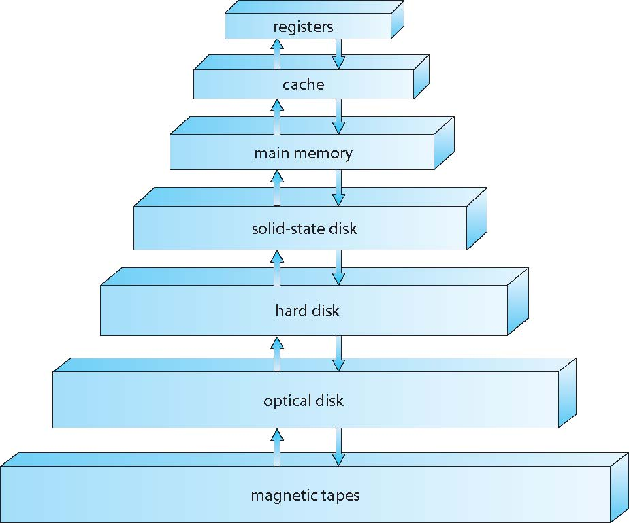
Storage Hierarchy
Storage-Device Hierarchy

Slide 13
Caching
Important principle, performed at many levels in a computer (in hardware, operating system, software)
Information in use copied from slower to faster storage temporarily
Faster storage (cache) checked first to determine if information is there
If it is, information used directly from the cache (fast)
If not, data copied to cache and used there
Cache smaller than storage being cached
Cache management important design problem
Cache size and replacement policy

Slide 14
Direct Memory Access
Used for high-speed I/O devices able to transmit information at close to memory speeds.
Device controller transfers blocks of data from buffer storage directly to main memory without CPU intervention.
Only one interrupt is generated per block, rather than the one interrupt per byte.

Slide 15
Operating System Structure
Multiprogramming (Batch system) needed for efficiency
Single user cannot keep CPU and I/O devices busy at all times
Multiprogramming organizes jobs (code and data) so CPU always has one to execute
A subset of total jobs in system is kept in memory.
One job selected and run via job scheduling.
When it has to wait (for I/O for example), OS switches to another job

Slide 16
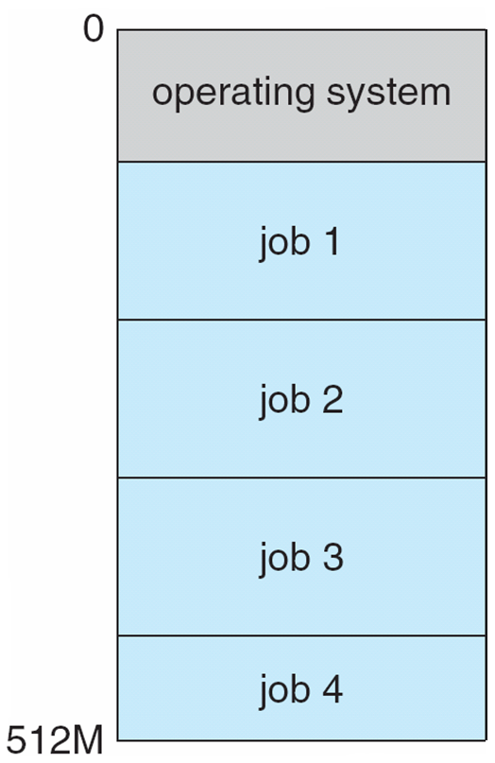
Operating System Structure
Timesharing (multitasking) is logical extension in which CPU switches jobs so frequently that users can interact with each job while it is running, creating interactive computing
Response time should be < 1 second
Each user has at least one program executing in memory process
If several jobs ready to run at the same time  CPU scheduling
If processes don’t fit in memory, swapping moves them in and out to run
Virtual memory allows execution of processes not completely in memory

Slide 17
Operating-System Structure Objectives
To discuss the various ways of structuring an operating system
To explore how operating systems are installed and customized and how they boot

Slide 18
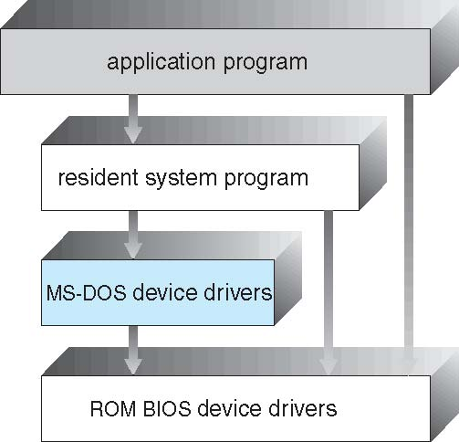
Simple Structure
MS-DOS – written to provide the most functionality in the least space
Not divided into modules
Although MS-DOS has some structure, its interfaces and levels of functionality are not well separated

Slide 19
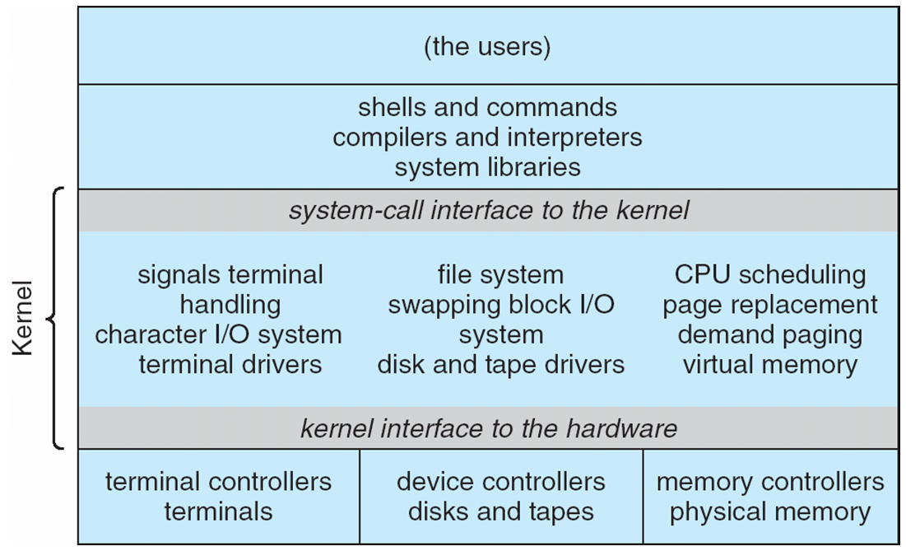
Traditional UNIX System Structure

Slide 20

UNIX – limited by hardware functionality, the original UNIX operating system had limited structuring.
Beyond simple but not fully layered
The UNIX OS consists of two separable parts
Systems programs
Kernel
Consists of everything below the system-call interface and above the physical hardware
Provides the file system, CPU scheduling, memory management, and other operating-system functions; a large number of functions for one level

Slide 21
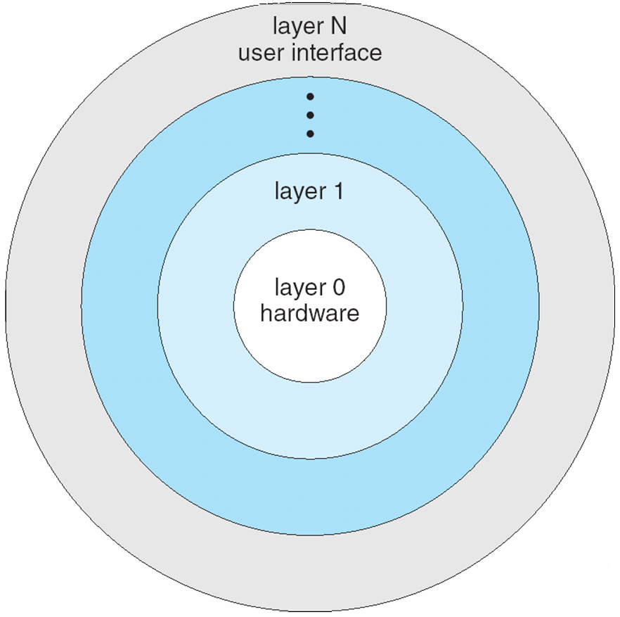
Layered Approach
The operating system is divided into a number of layers (levels), each built on top of lower layers.
The bottom layer (layer 0), is the hardware; the highest (layer N) is the user interface.

Slide 22
Microkernel System Structure
Moves as much from the kernel into user space
Mach example of microkernel
Mac OS X kernel (Darwin) partly based on Mach
Communication takes place between user modules using message passing
Benefits:
Easier to extend a microkernel
Easier to port the operating system to new architectures
More reliable (less code is running in kernel mode)
More secure
Detriments:
Performance overhead of user space to kernel space communication

Slide 23
Microkernel System Structure

Slide 24
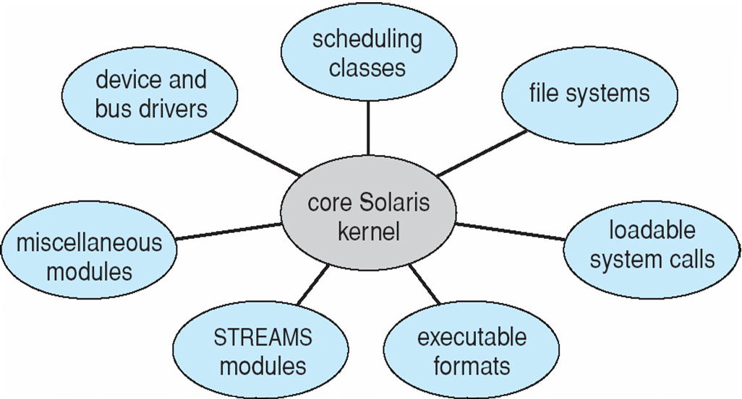
Module Approach
Many modern operating systems implement loadable kernel modules
Uses object-oriented approach
Each core component is separate
Each talks to the others over known interfaces
Each is loadable as needed within the kernel
Overall, similar to layers but with more flexible
Linux, Solaris, etc

Slide 25
Microkernel System Structure
Moves as much from the kernel into user space
Mach example of microkernel
Mac OS X kernel (Darwin) partly based on Mach
Communication takes place between user modules using message passing
Benefits:
Easier to extend a microkernel
Easier to port the operating system to new architectures
More reliable (less code is running in kernel mode)
More secure
Detriments:
Performance overhead of user space to kernel space communication

Slide 26
Process Concept
An operating system executes a variety of programs:
Batch system – jobs
Time-shared systems – user programs or tasks
Process – a program in execution; process execution must progress in sequential fashion
Multiple parts
The program code, also called text section
Current activity including program counter, processor registers
Stack containing temporary data
Function parameters, return addresses, local variables
Data section containing global variables
Heap containing memory dynamically allocated during run time

Slide 27
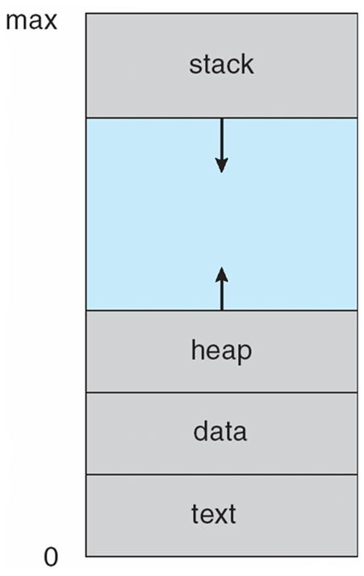
Process Concept (Cont.)
Program is passive entity stored on disk (executable file), process is active
Program becomes process when executable file loaded into memory
Execution of program started via GUI mouse clicks, command line entry of its name, etc
One program can be several processes
Consider multiple users executing the same program

Slide 28
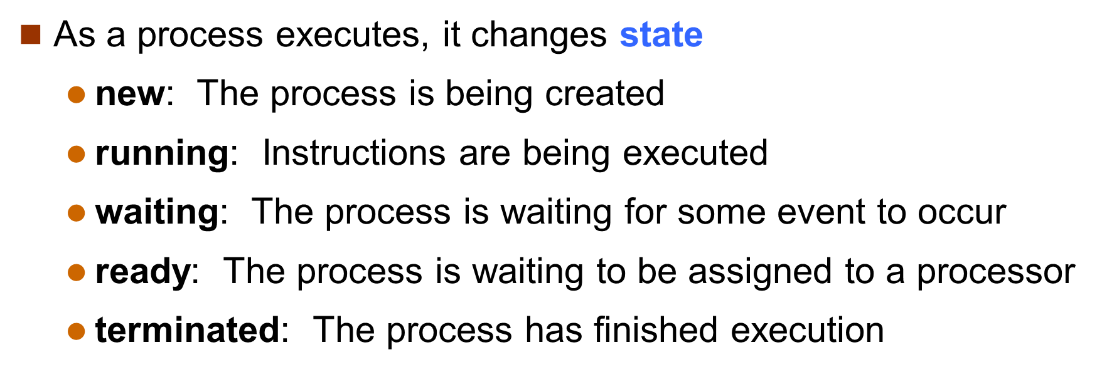
Process State

Slide 29

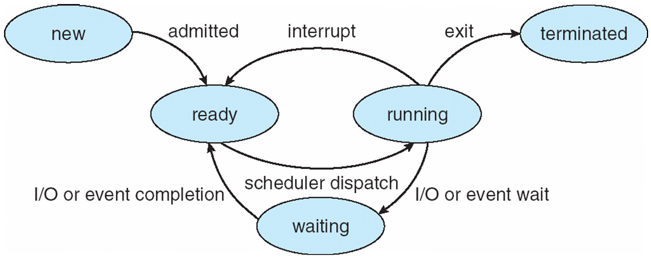
Diagram of Process State

Slide 30
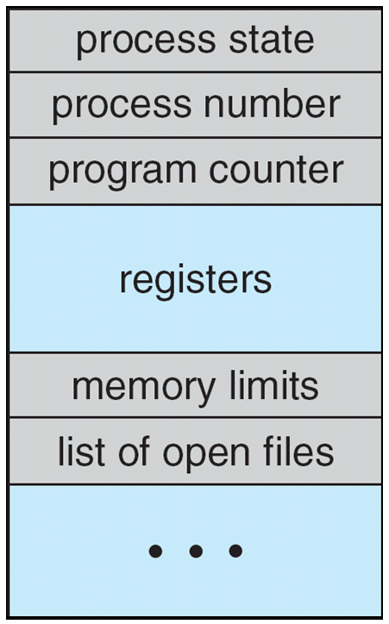
Process Control Block (PCB)
Information associated with each process
(also called task control block)
Process state – running, waiting, etc
Program counter – location of instruction to next execute
CPU registers – contents of all process-centric registers

Slide 31
Process Control Block (PCB)
CPU scheduling information- priorities, scheduling queue pointers
Memory-management information – memory allocated to the process
Accounting information – CPU used, clock time elapsed since start, time limits
I/O status information – I/O devices allocated to process, list of open files

Slide 32
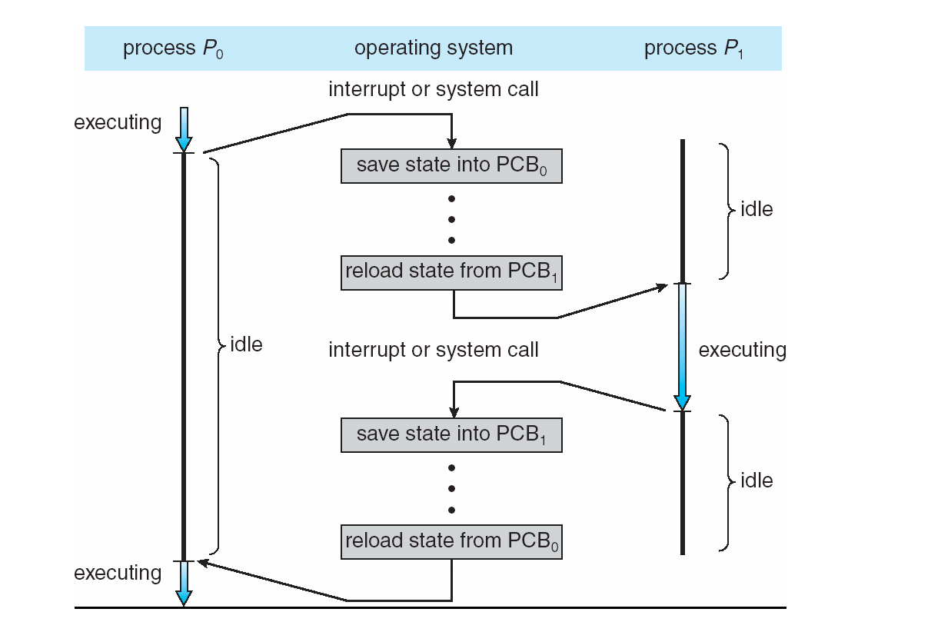
CPU Switch From Process to Process

Slide 33
Process Scheduling
Maximize CPU use, quickly switch processes onto CPU for time sharing
Process scheduler selects among available processes for next execution on CPU
Maintains scheduling queues of processes
Job queue – set of all processes in the system
Ready queue – set of all processes residing in main memory, ready and waiting to execute
Device queues – set of processes waiting for an I/O device
Processes migrate among the various queues

Slide 34
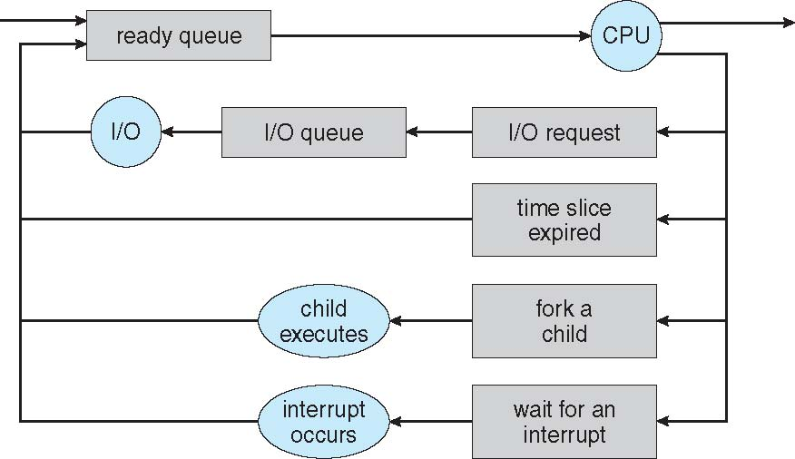
Representation of Process Scheduling
Queueing diagram represents queues, resources, flows

Slide 35
Schedulers
Short-term scheduler (or CPU scheduler) – selects which process should be executed next and allocates CPU
Sometimes the only scheduler in a system
Short-term scheduler is invoked frequently (milliseconds) ⇒ (must be fast)
Long-term scheduler (or job scheduler) – selects which processes should be brought into the ready queue
Long-term scheduler is invoked infrequently (seconds, minutes) ⇒ (may be slow)
The long-term scheduler controls the degree of multiprogramming

Slide 36
Schedulers
Processes can be described as either:
I/O-bound process – spends more time doing I/O than computations, many short CPU bursts
CPU-bound process – spends more time doing computations; few very long CPU bursts
Long-term scheduler strives for good process mix

Slide 37
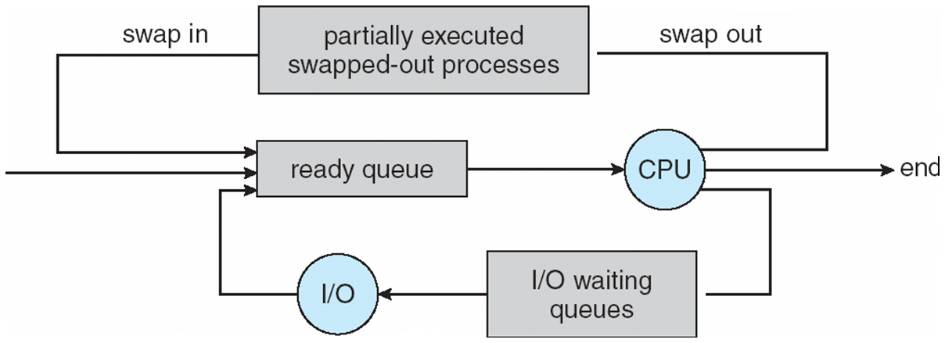
Medium Term Scheduling
Medium-term scheduler can be added if degree of multiple programming needs to decrease
Remove process from memory, store on disk, bring back in from disk to continue execution: swapping

Slide 38
Context Switch
When CPU switches to another process, the system must save the state of the old process and load the saved state for the new process via a context switch
Context of a process represented in the PCB
Context-switch time is overhead; the system does no useful work while switching
The more complex the OS and the PCB ➔ the longer the context switch
Time dependent on hardware support
Some hardware provides multiple sets of registers per CPU ➔ multiple contexts loaded at once

Slide 39
Operations on Processes
System must provide mechanisms for:
process creation
process termination,

Slide 40
Process Creation
Parent process create children processes, which, in turn create other processes, forming a tree of processes
Generally, process identified and managed via a process identifier (pid)
Resource sharing options
Parent and children share all resources
Children share subset of parent’s resources
Parent and child share no resources
Execution options
Parent and children execute concurrently
Parent waits until children terminate

Slide 41
A Tree of Processes in Linux

Slide 42
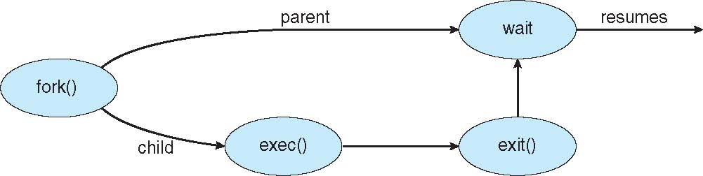
Process Creation (Cont.)
Address space
Child duplicate of parent
Child has a program loaded into it
UNIX examples
fork() system call creates new process
exec() system call used after a fork() to replace the process’ memory space with a new program

Slide 43
Process Termination
Process executes last statement and then asks the operating system to delete it using the exit() system call.
Returns status data from child to parent (via wait())
Process’ resources are deallocated by operating system
Parent may terminate the execution of children processes using the abort() system call. Some reasons for doing so:
Child has exceeded allocated resources
Task assigned to child is no longer required
The parent is exiting and the operating systems does not allow a child to continue if its parent terminates

Slide 44
Inter Process Communication
Processes within a system may be independent
or cooperating
Cooperating process can affect or be affected by other processes, including sharing data
Reasons for cooperating processes:
Information sharing
Computation speedup
Modularity
Convenience
Cooperating processes need inter process communication (IPC)
Two models of IPC
Shared memory
Message passing

Slide 45
Communications Models
(a) Message passing. (b) shared memory.

Slide 46
Cooperating Processes
Independent process cannot affect or be affected by the execution of another process
Cooperating process can affect or be affected by the execution of another process
Advantages of process cooperation
Information sharing
Computation speed-up
Modularity
Convenience

Slide 47
Producer-Consumer Problem
Paradigm for cooperating processes, producer process produces information that is consumed by a consumer process
unbounded-buffer places no practical limit on the size of the buffer
bounded-buffer assumes that there is a fixed buffer size

Slide 48
Bounded Buffer – Shared-Memory Solution
Shared data
#define BUFFER_SIZE 10
typedef struct {
. . .
} item;
item buffer[BUFFER_SIZE];
int in = 0;
int out = 0;
Solution is correct, but can only use BUFFER_SIZE-1 elements

Slide 49
Bounded-Buffer – Producer
item next_produced;
while (true) {
/* produce an item in next produced */
while (((in + 1) % BUFFER_SIZE) == out)
; /* do nothing */
buffer[in] = next_produced;
in = (in + 1) % BUFFER_SIZE;
}

Slide 50
Bounded Buffer – Consumer
item next_consumed;
while (true) { while (in == out)
; /* do nothing */ next_consumed = buffer[out];
out = (out + 1) % BUFFER_SIZE;a /* consume the item in next consumed */
}

Slide 51
Inter Process Communication – Shared Memory
An area of memory shared among the processes that wish to communicate
The communication is under the control of the users processes not the operating system.
Major issues is to provide mechanism that will allow the user processes to synchronize their actions when they access shared memory.

Slide 52
Inter Process Communication – Message Passing
Mechanism for processes to communicate and to synchronize their actions
Message system – processes communicate with each other without resorting to shared variables
IPC facility provides two operations:
send(message)
receive(message)
The message size is either fixed or variable

Slide 53
Message Passing (Cont.)
If processes P and Q wish to communicate, they need to:
Establish a communication link between them
Exchange messages via send/receive
Implementation issues:
How are links established?
Can a link be associated with more than two processes?
How many links can there be between every pair of communicating processes?
What is the capacity of a link?
Is the size of a message that the link can accommodate fixed or variable?
Is a link unidirectional or bi-directional?

Slide 54
Message Passing (Cont.)
Implementation of communication link
Physical:
Shared memory
Hardware bus
Network
Logical:
Direct or indirect
Synchronous or asynchronous
Automatic or explicit buffering

Slide 55
Direct Communication
Processes must name each other explicitly:
send (P, message) – send a message to process P
receive(Q, message) – receive a message from process Q
Properties of communication link
Links are established automatically
A link is associated with exactly one pair of communicating processes
Between each pair there exists exactly one link
The link may be unidirectional, but is usually bi-directional

Slide 56
Indirect Communication
Messages are directed and received from mailboxes (also referred to as ports)
Each mailbox has a unique id
Processes can communicate only if they share a mailbox
Properties of communication link
Link established only if processes share a common mailbox
A link may be associated with many processes
Each pair of processes may share several communication links
Link may be unidirectional or bi-directional

Slide 57
Indirect Communication
Operations
create a new mailbox (port)
send and receive messages through mailbox
destroy a mailbox
Primitives are defined as:
send(A, message) – send a message to mailbox A
receive(A, message) – receive a message from mailbox A

Slide 58
Indirect Communication
Mailbox sharing
P₁, P₂, and P₃ share mailbox A
P₁, sends; P₂ and P₃ receive
Who gets the message?
Solutions
Allow a link to be associated with at most two processes
Allow only one process at a time to execute a receive operation
Allow the system to select arbitrarily the receiver. Sender is notified who the receiver was.

Slide 59
Synchronization
Message passing may be either blocking or non-blocking
Blocking is considered synchronous
Blocking send -- the sender is blocked until the message is received
Blocking receive -- the receiver is blocked until a message is available
Non-blocking is considered asynchronous
Non-blocking send -- the sender sends the message and continue
Non-blocking receive -- the receiver receives:
A valid message, or
Null message
Different combinations possible
If both send and receive are blocking, we have a rendezvous

Slide 60
Buffering
Queue of messages attached to the link and implemented in one of three ways
Zero capacity – no messages are queued on a link. Sender must wait for receiver (rendezvous)
Bounded capacity – finite length of n messages Sender must wait if link full
3. Unbounded capacity – infinite length Sender never waits

Slide 61
CPU Scheduling
Basic Concepts
Scheduling Criteria
Scheduling Algorithms
Multiple-Processor Scheduling

Slide 62
Objectives
To introduce CPU scheduling, which is the basis for multi programmed operating systems
To describe various CPU-scheduling algorithms
To discuss evaluation criteria for selecting a CPU-scheduling algorithm for a particular system
To examine the scheduling algorithms of several operating systems

Slide 63
Basic Concepts
Maximum CPU utilization obtained with multiprogramming
CPU–I/O Burst Cycle – Process execution consists of a cycle of CPU execution and I/O wait
CPU burst followed by I/O burst
CPU burst distribution is of main concern

Slide 64
CPU Scheduler
Short-term scheduler selects from among the processes in ready queue, and allocates the CPU to one of them
Queue may be ordered in various ways
CPU scheduling decisions may take place when a process:
1. Switches from running to waiting state
2. Switches from running to ready state
3. Switches from waiting to ready
Terminates
Scheduling under 1 and 4 is nonpreemptive
All other scheduling is preemptive
Consider access to shared data
Consider preemption while in kernel mode
Consider interrupts occurring during crucial OS activities

Slide 65
Dispatcher
Dispatcher module gives control of the CPU to the process selected by the short-term scheduler;
This involves:
switching context
switching to user mode
jumping to the proper location in the user program to restart that program
Dispatch latency – time it takes for the dispatcher to stop one process and start another running

Slide 66
Scheduling Criteria
CPU utilization – keep the CPU as busy as possible
Throughput – # of processes that complete their execution per time unit
Turnaround time – amount of time to execute a particular process
Waiting time – amount of time a process has been waiting in the ready queue
Response time – amount of time it takes from when a request was submitted until the first response is produced, not output (for time-sharing environment)

Slide 67
Scheduling Algorithm Optimization Criteria
Max CPU utilization
Max throughput
Min turnaround time
Min waiting time
Min response time

Slide 68
First- Come, First-Served (FCFS) Scheduling
Process Burst Time
P₁ 24
P₂ 3
P₃ 3
Suppose that the processes arrive in the order: P₁ , P₂ , P₃ The Gantt Chart for the schedule is:
Waiting time for P₁ = 0; P₂ = 24; P₃ = 27
Average waiting time: (0 + 24 + 27)/3 = 17

Slide 69
FCFS Scheduling (Cont.)
Suppose that the processes arrive in the order:
P₂ , P₃ , P₁
The Gantt chart for the schedule is:
Waiting time for P₁ = 6; P₂ = 0; P₃ = 3
Average waiting time: (6 + 0 + 3)/3 = 3
Much better than previous case
Convoy effect - short process behind long process
Consider one CPU-bound and many I/O-bound processes

Slide 70
Shortest-Job-First (SJF)
Associate with each process the length of its next CPU burst
Use these lengths to schedule the process with the shortest time
SJF is optimal – gives minimum average waiting time for a given set of processes
The difficulty is knowing the length of the next CPU request
Could ask the user

Slide 71
Example of SJF
ProcessArriva l Time Burst Time
P₁ 0.0 6
P₂ 2.0 8
P₃ 4.0 7
P₄ 5.0 3
SJF scheduling chart
Average waiting time = (3 + 16 + 9 + 0) / 4 = 7

Slide 72
Shortest-Remaining-Time-First
Now we add the concepts of varying arrival times and preemption to the analysis
Process Arrival Time Burst Time
P₁ 0 8
P₂ 1 4
P₃ 2 9
P₄ 3 5
Preemptive SJF Gantt Chart
Average waiting time = [(10-1)+(1-1)+(17-2)+5-3)]/4 = 26/4 = 6.5 msec

Slide 73
Priority Scheduling
A priority number (integer) is associated with each process
The CPU is allocated to the process with the highest priority (smallest integer ≡ highest priority)
Preemptive
Nonpreemptive
SJF is priority scheduling where priority is the inverse of predicted next CPU burst time
Problem ≡ Starvation – low priority processes may never execute
Solution ≡ Aging – as time progresses increase the priority of the process

Slide 74
Example of Priority Scheduling
Process Burst Time Priority
P₁ 10 3
P₂ 1 1
P₃ 2 4
P₄ 1 5
P₅ 5 2
Priority scheduling Gantt Chart
Average waiting time = 8.2 msec

Slide 75
Round Robin (RR)
Each process gets a small unit of CPU time (time quantum q), usually 10-100 milliseconds. After this time has elapsed, the process is preempted and added to the end of the ready queue.
If there are n processes in the ready queue and the time quantum is q, then each process gets 1/n of the CPU time in chunks of at most q time units at once.

Slide 76
Round Robin (RR)
No process waits more than (n-1)q time units.
Timer interrupts every quantum to schedule next process
Performance
q large ⇒ FIFO
q small ⇒ q must be large with respect to context switch, otherwise overhead is too high

Slide 77
Ex. of RR with Time Quantum = 4
Process Burst Time
P₁ 24
P₂ 3
P₃ 3
The Gantt chart is: Typically, higher average turnaround than SJF, but better response
q should be large compared to context switch time
q usually 10ms to 100ms, context switch < 10 usec

Slide 78
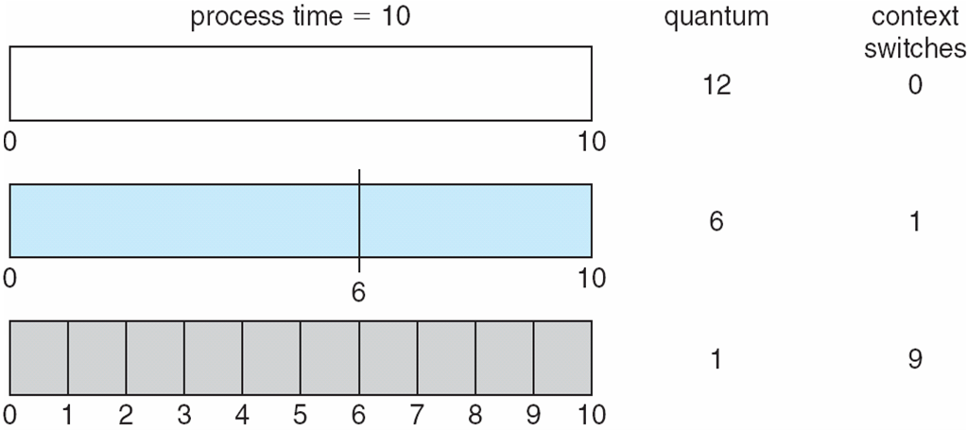
Time Quantum & Context Switch Time

Slide 79
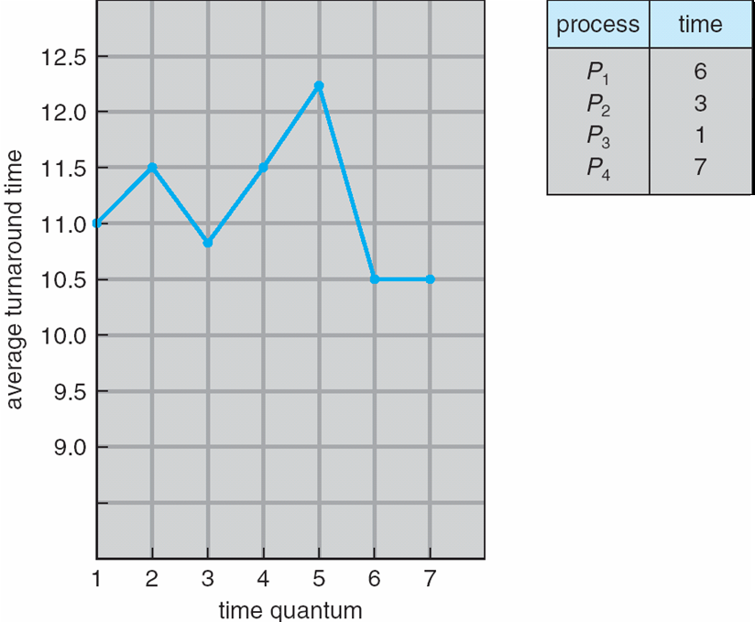
Turnaround Time Varies With The Time Quantum
80% of CPU bursts should be shorter than q

Slide 80
Multilevel Queue
Ready queue is partitioned into separate queues, eg:
foreground (interactive)
background (batch)
Process permanently in a given queue
Each queue has its own scheduling algorithm:
Fore ground – RR
Back ground – FCFS

Slide 81
Multilevel Queue
Scheduling must be done between the queues:
Fixed priority scheduling; (i.e., serve all from foreground then from background). Possibility of starvation.
Time slice – each queue gets a certain amount of CPU time which it can schedule amongst its processes; i.e., 80% to foreground in RR
20% to background in FCFS

Slide 82
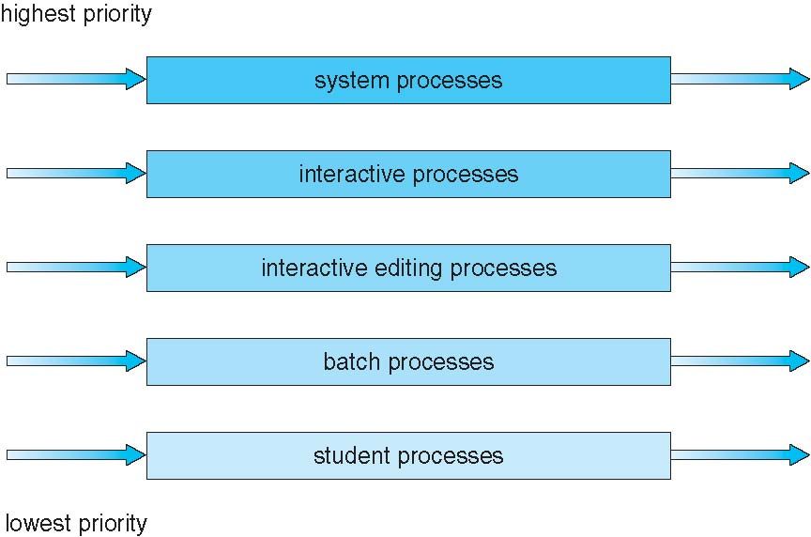
Multilevel Queue Scheduling

Slide 83
Multilevel Feedback Queue
A process can move between the various queues; aging can be implemented this way
Multilevel-feedback-queue scheduler defined by the following parameters:
Number of queues
Scheduling algorithms for each queue
Method used to determine when to upgrade a process
Method used to determine when to demote a process
Method used to determine which queue a process will enter when that process needs service

Slide 84
Example of Multilevel Feedback Queue
Three queues:
Q₀ – RR with time quantum 8 milliseconds
Q₁ – RR time quantum 16 milliseconds
Q₂ – FCFS
Scheduling
A new job enters queue Q₀ which is served FCFS
When it gains CPU, job receives 8 milliseconds
If it does not finish in 8 milliseconds, job is moved to queue Q₁
At Q₁ job is again served FCFS and receives 16 additional ms
If it still does not complete, it is preempted and moved to queue Q₂

Slide 85
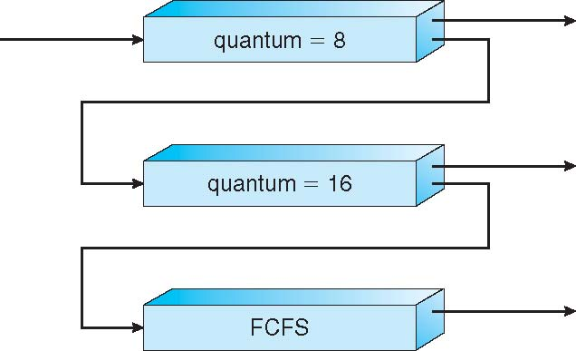
Example of Multilevel Feedback Queue

Slide 86
End

